Slide 1

PES POLYTECHNIC (563)
Sagar road, Shivamogga
Department of Computer Science and Engineering
Project title
“Digitalization of Crime Reporting system”
Team members
Name Register Number
Khazi Abdul Athifulla 563CS23018
Syed Sameer. S 563CS23044
Umar farooq 563CS24704
Under Guidance of
Ms Indu.A B.E
Lecturer, Dept of CSE,
PES Polytechnic, Shivamogga

Slide 2
Table of Contents
Project Abstract
Project Objectives
Problem Statement
Technical Stack (Hardware, Software Tools)
System architecture , Flow Diagram
Testing Methodology used
Project Management ( Cost/Budget , Time line )
Results (Screenshots)
Conclusion
Future Scope
References

Slide 3
Abstract
The Crime Reporting System and e-FIR is a web-based application designed to modernize the process of reporting crimes and filing First Information Reports. Citizens can register, log in, and submit crime reports from anywhere without visiting a police station. The system supports online FIR filing, real-time case tracking, and administrative management. It bridges the gap between citizens and law enforcement by providing a transparent, efficient, and secure platform. The project aims to reduce response time, minimize paperwork, improve record management, and make justice more accessible to all.

Slide 4







Objective
What we aim to achieve with E-FIR
Primary Goal
To develop a secure, web-based Electronic First Information Report (E-FIR) system that enables citizens to register complaints digitally — eleminating the need to visit a police station in person.
Paperless FIR Filing
Transparent Tracking
Citizen Empowerment
Replace manual, paper-based FIR processes with a fully digital online platform accessible 24/7.
Allow complainants to track FIR status in real-time with unique reference IDs and SMS/email alerts.
Make crime reporting easier, faster, and accessible to all citizens regardless of location.
Admin Dashboard
Secure Data Storage
Reduce Response Time
Equip police officers with a centralized dashboard for efficient case management and data analytics.
Store all FIR data in an encrypted, centralized database ensuring integrity and confidentiality.
Streamline the process so authorities can act on reports faster through automated routing.

Slide 5

Problem Statement
Limitations of the traditional FIR system
Physical Presence Required
Citizens must visit a police station in person, creating barriers for the elderly, disabled, and distant residents.
Lengthy Manual Processing
Paper-based FIRs involve repetitive data entry, increasing time taken and risk of errors or omissions.
The Problem
Lack of Status Transparency
No real-time tracking system — citizens are unaware of investigation progress after filing an FIR.
Millions of citizens in India face barriers when filing a First Information Report. The existing manual process is slow, opaque, and prone to errors — discouraging crime reporting.
Data Loss & Tampering Risk
Physical records are vulnerable to loss, damage, or manipulation without a secure digital backup.
Fear of Harassment / Bias
Fear of police misconduct discourages victims from physically reporting crimes at stations.
Only ~30% of crimes are formally reported*
*Source: NCRB India 2022

Slide 6








Description of Technology Used
HTML
CSS
PHP
Web page structure
User interface design and styling
Backend logic and server-side scripting
MySQL
XAMPP
Database management and data storage
Local server for development environment

Slide 7


Hardware Specifications
The system requires basic computing hardware to operate efficiently.
Component
Component
Minimum Requirements
Processor (CPU)
Processor (CPU)
Intel Core i5 or above version
Intel Core i5 or above version
Memory (RAM)
Memory (RAM)
16 GB or above
16 GB or above
Storage (Hard Disk)
Storage (Hard Disk)
90 GB or above

Slide 8
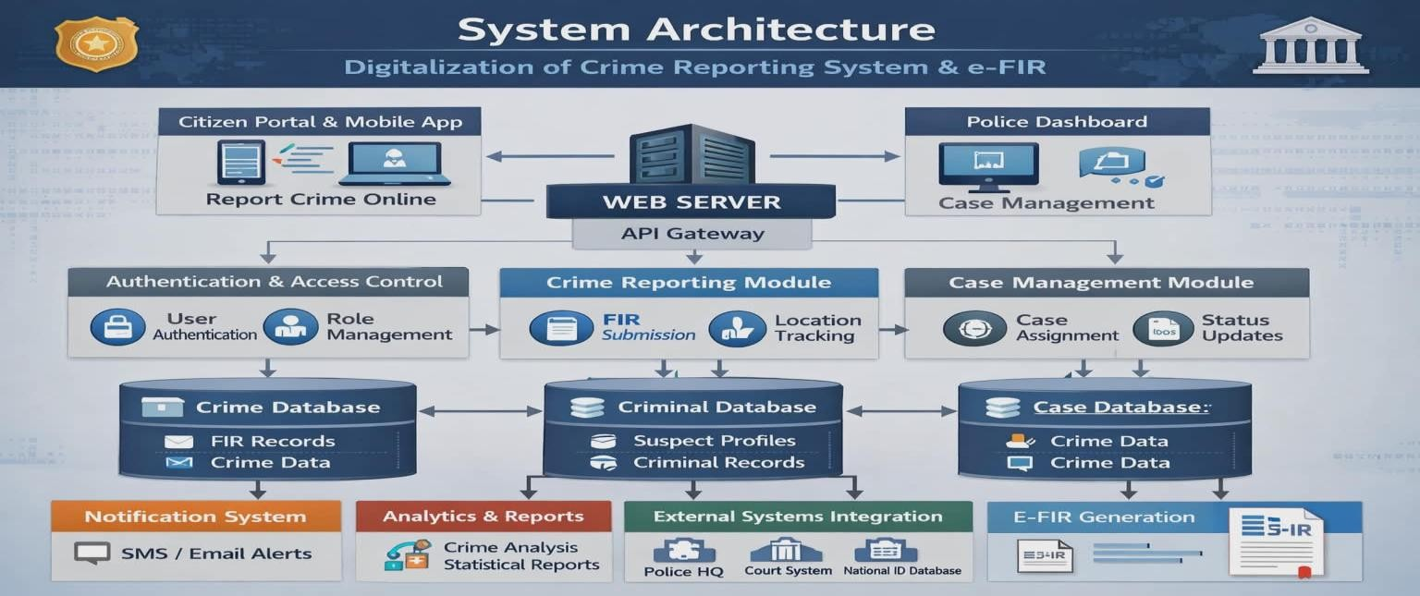
System Architecture Diagram
E-FIR | Digitalization of Crime Reporting System
Confidential

Slide 9
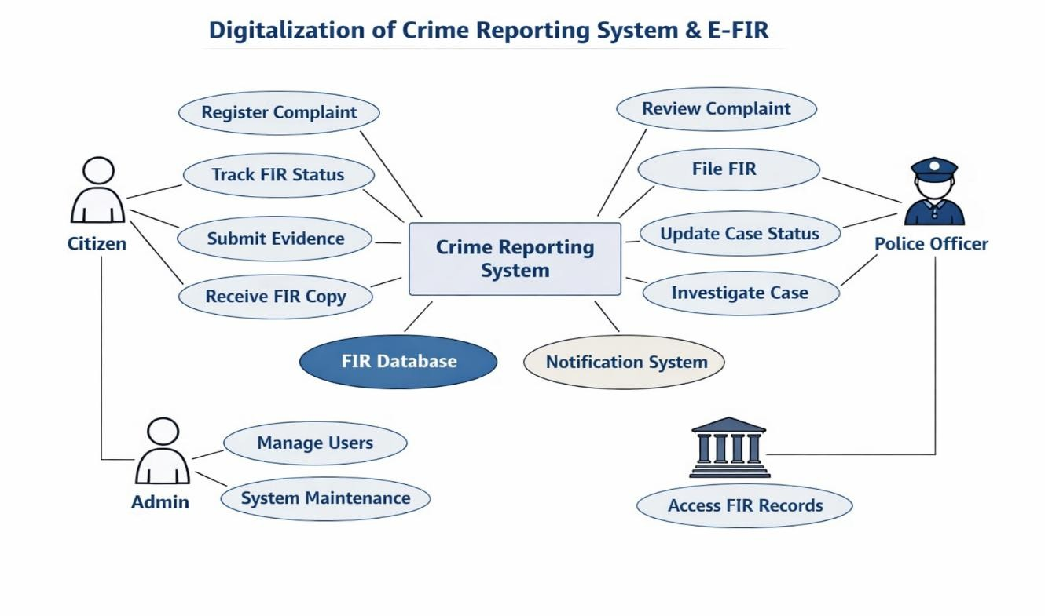





E-FIR Flow Diagram

Slide 10
Testing Methodology
Unit Testing
Integration Testing
Tested each module independently (FIR form, login, report submission)
Checked seamless data flow between Citizen Portal & Admin Dashboard
Verified input validation, error handling & output correctness
Verified database connectivity, record insertion, retrieval & update
Tested edge cases: duplicate FIR, invalid credentials, empty fields
Validated notification triggers after FIR status changes

Slide 11
Testing Methodology (Continued)
Functional Testing
User Acceptance Testing (UAT)
Verified all citizen and admin functions end-to-end
Checked system output matched expected behaviour
Validated role-based access restrictions for admin vs citizen
Tested by real users (students, faculty) for usability & clarity
Confirmed FIR submission and tracking displayed correctly
Feedback incorporated to improve navigation & UI
Testing Results
✔ All test cases passed successfully
✔ No critical bugs; minor UI issues resolved before final release
✔ System performed as expected under normal and edge-case scenarios

Slide 12
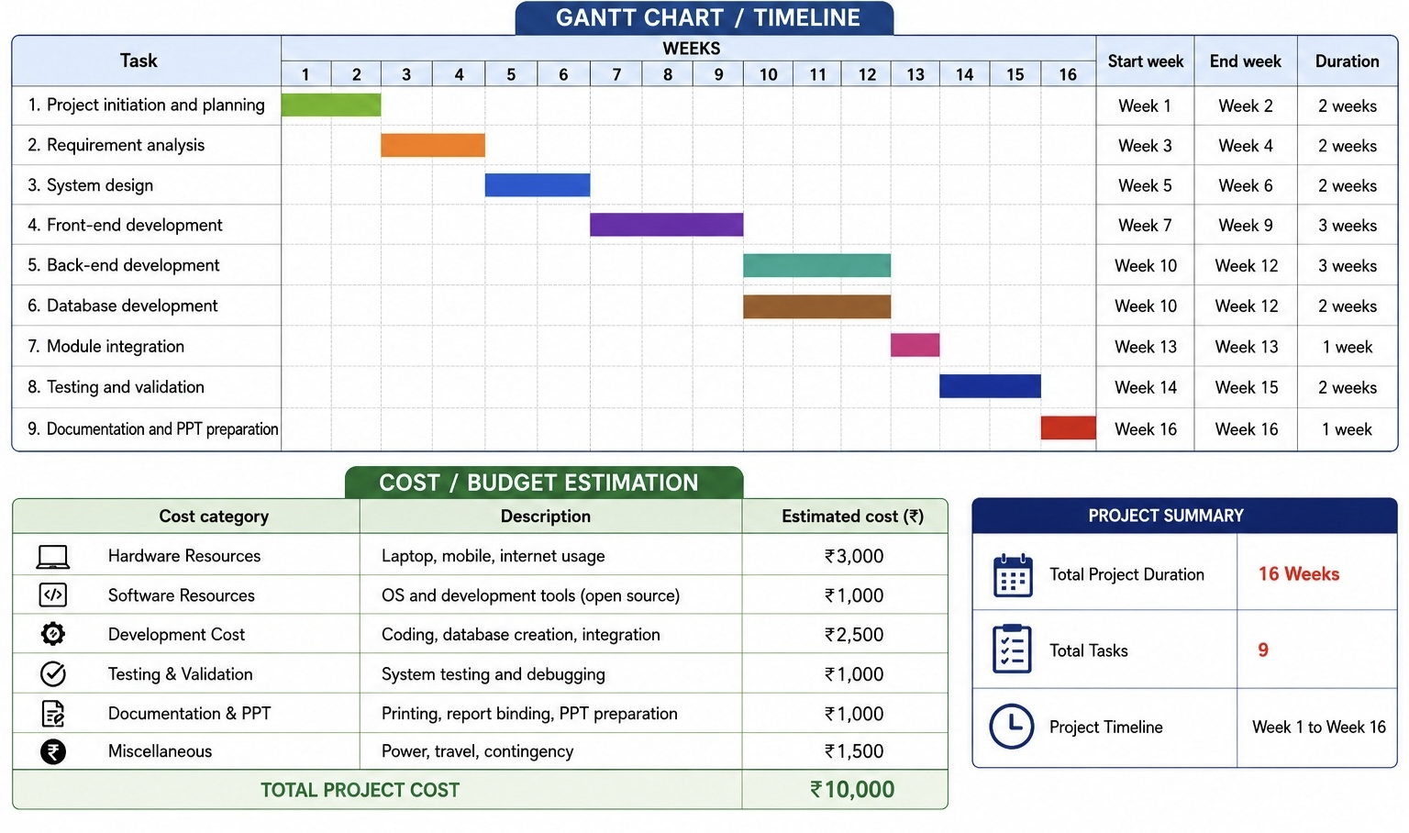

Slide 13
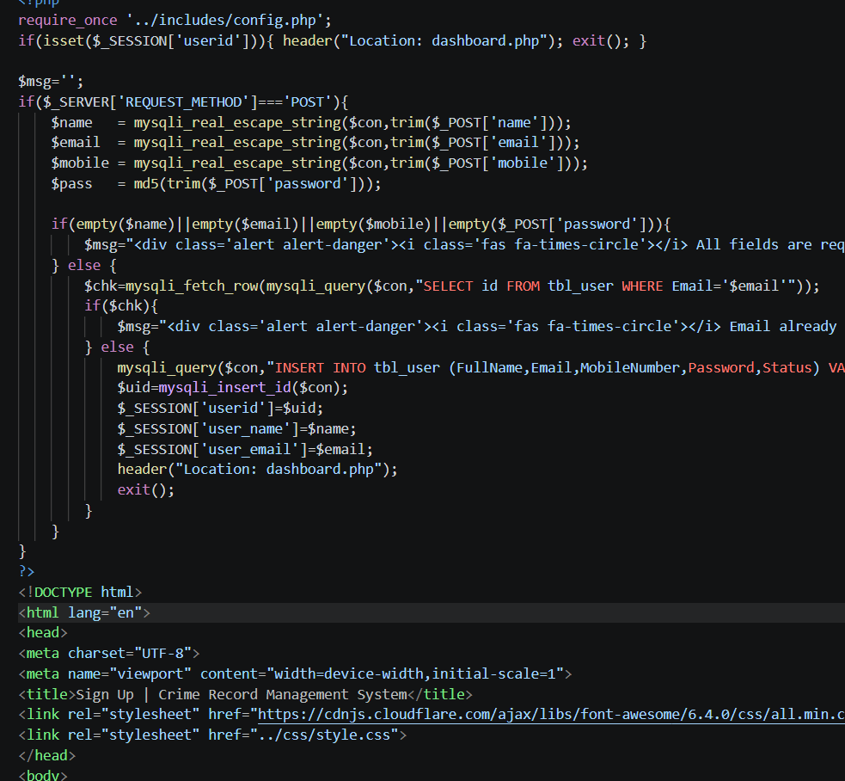
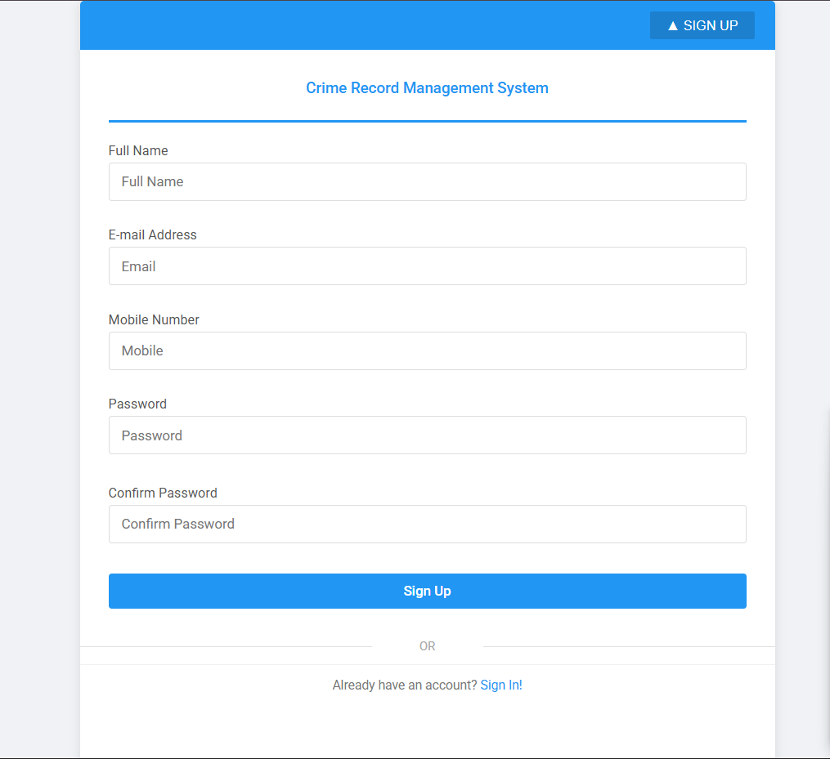
Code with snapshot output
Screenshot : Registration form collecting name, email, phone, password, and user type.

Slide 14
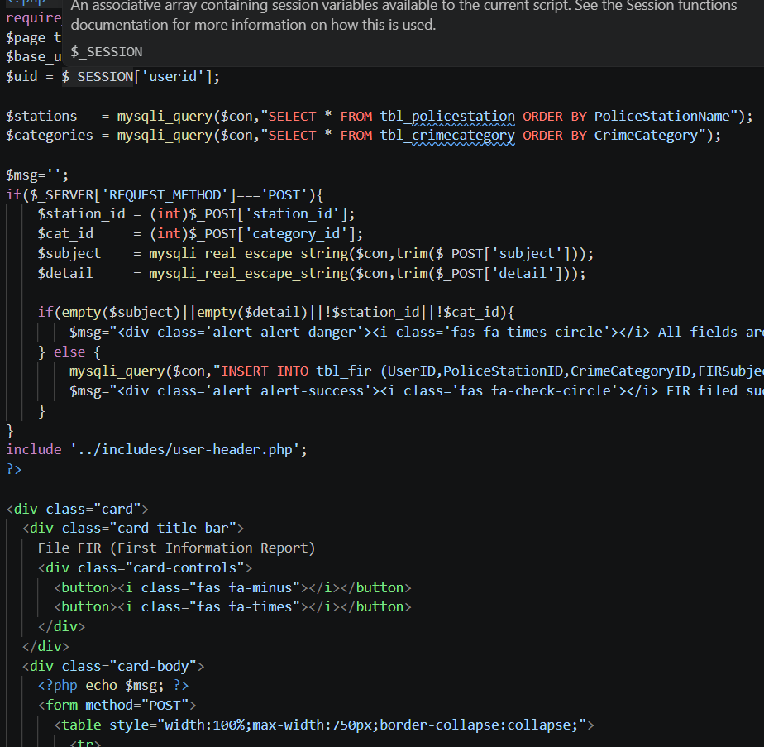
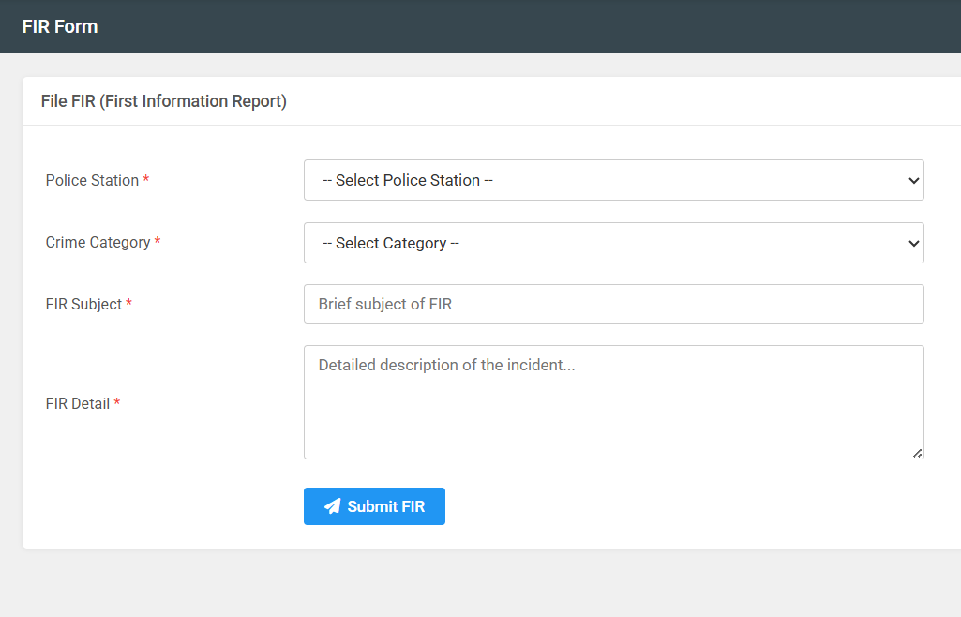
Code with snapshot output
Screenshot : FIR filing form with fields for crime type, incident date, location, description, and suspect details.

Slide 15
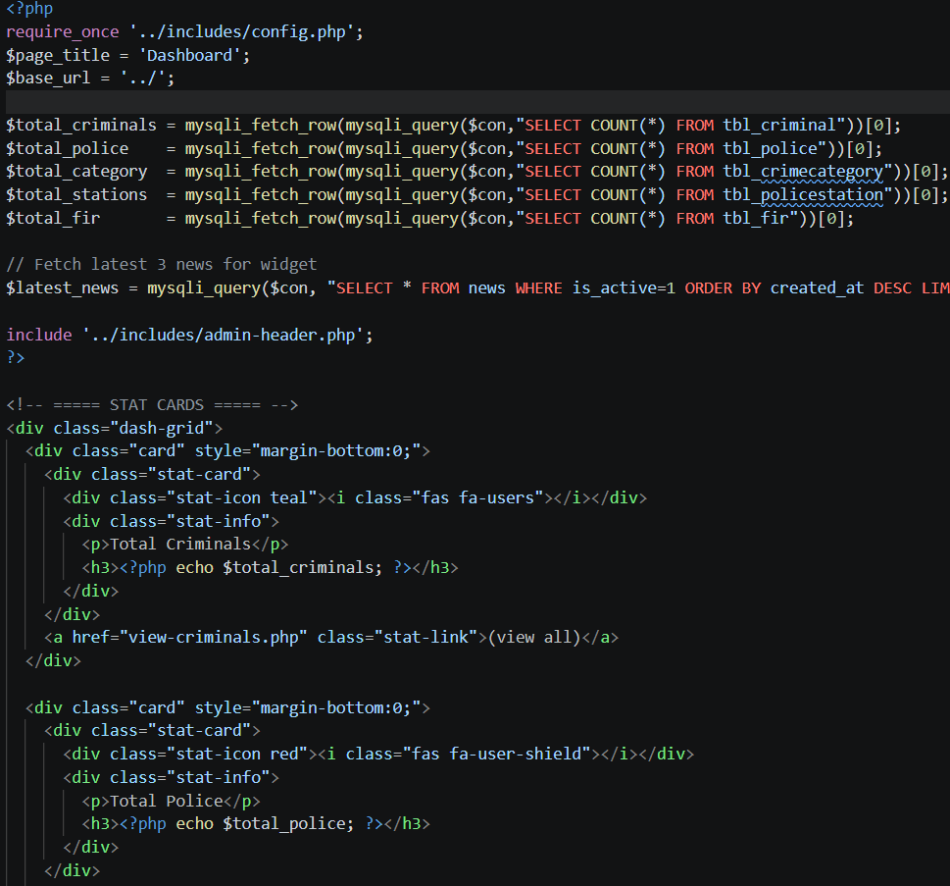
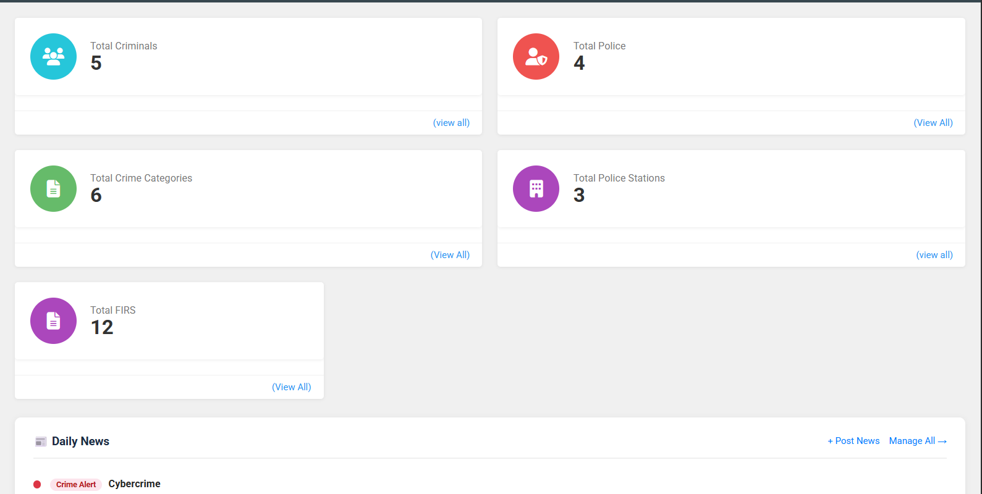
Code with snapshot output
Screenshot: Admin panel listing all submitted FIRs with options to assign officers and update status.

Slide 16
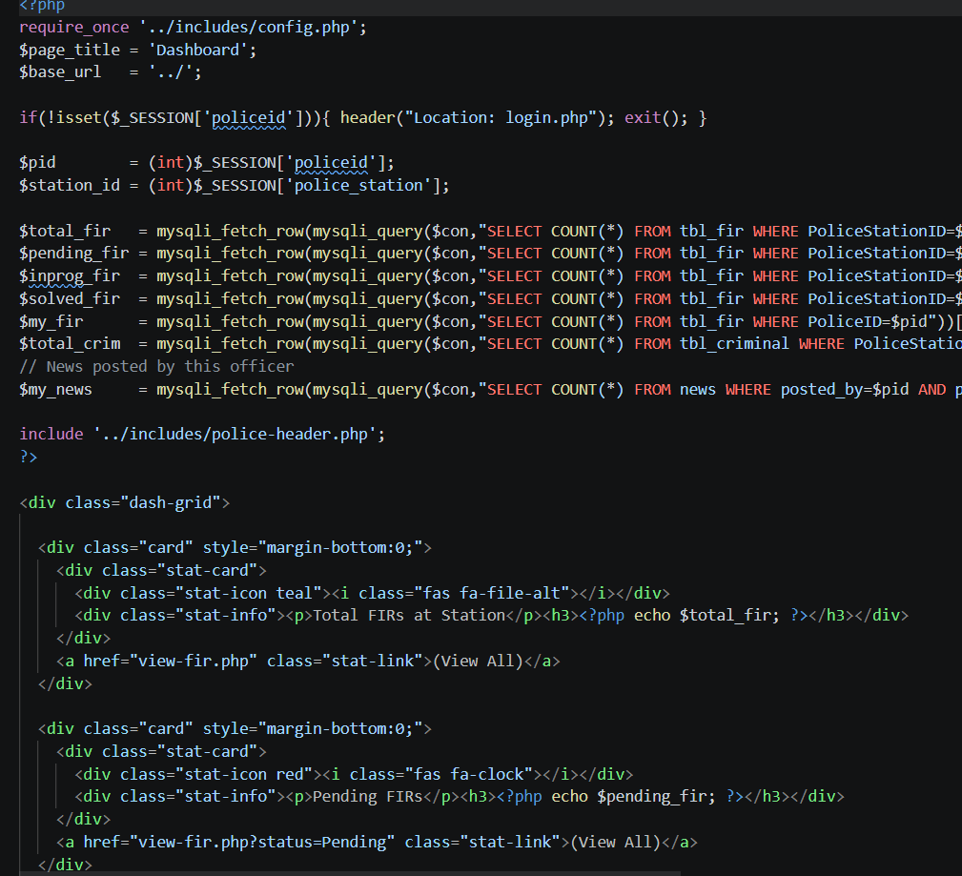
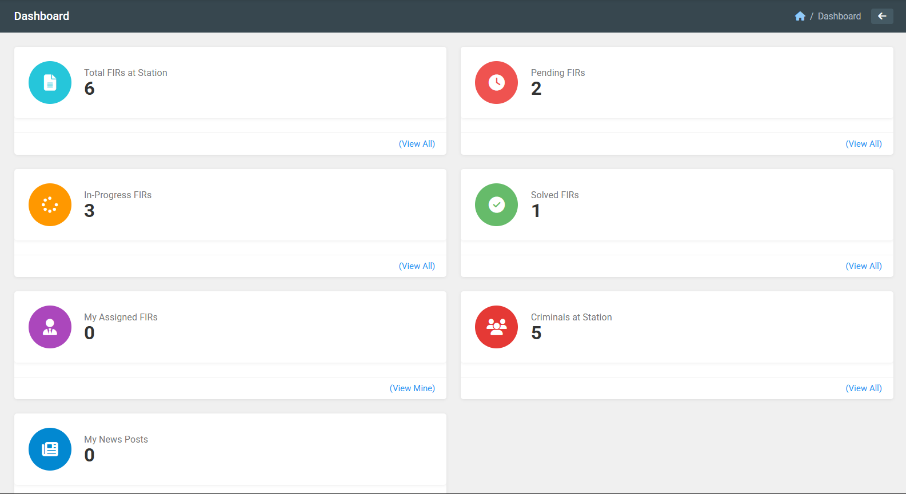
Code with snapshot output
Screenshot: Officer view showing assigned FIRs and case update options.

Slide 17



Conclusion
What We Achieved
The E-FIR system successfully digitizes the entire crime reporting lifecycle — from complaint submission to FIR closure — making the process transparent, efficient, and citizen-friendly.
Reduced FIR filing time from hours to under 5 minutes
Eliminated physical station visits for non-emergency reports
End-to-end encrypted storage ensures data integrity & privacy
Real-time SMS/email alerts improve citizen trust in policing
Centralised analytics help authorities identify crime hotspots
"Digitalization of crime reporting is not just a technical upgrade — it is a step toward justice for every citizen."

Slide 18






Future Scope
Planned enhancements and next-generation features for E-FIR
AI-Powered Crime Analytics
Native Mobile App (iOS & Android)
AI Chatbot Assistance
Integrate machine learning models to predict crime hotspots, classify FIR severity, and assist officers with evidence correlation.
Dedicated apps with offline FIR drafting, biometric login, GPS-tagged incident location, and push notifications.
24/7 multilingual chatbot to guide citizens through the FIR filing process in regional languages including Kannada, Hindi, Tamil.
Blockchain-Based FIR Records
Face & Fingerprint Biometrics
Inter-State Case Coordination
Immutable blockchain ledger to store FIR records, preventing tampering and ensuring auditability across police jurisdictions.
Aadhaar-linked biometric verification for complainant identity, reducing false FIRs and improving record accuracy.
Unified national FIR database linking state police systems for cross-border crime tracking and jurisdiction transfers.

Slide 19
References
Cited sources, government portals & academic literature
[1]
National Crime Records Bureau (NCRB), India — Annual Crime in India Report 2022. Ministry of Home Affairs, Govt. of India. ncrb.gov.in
[2]
Ministry of Electronics & IT — Digital India Programme Overview. meity.gov.in/digital-india
[3]
Twilio Documentation — SMS API for OTP & Notifications. developer.twilio.com
[4]
OWASP Top 10 Web Application Security Risks 2023. owasp.org/Top10
[5]
Express.js Official Documentation — Node.js Web Framework. expressjs.com
[6]
MySQL 8.0 Reference Manual — Oracle Corporation. dev.mysql.com/doc
[7]
JSON Web Tokens (JWT) — Introduction & Best Practices. jwt.io/introduction
[8]
Patil, R. & Sharma, A. (2023). 'E-Governance in Indian Policing: Challenges & Opportunities.' International Journal of Computer Applications, Vol. 183.

Slide 20

Thank You!
Questions & Discussion
E-FIR: Digitalization of Crime Reporting System
Academic Year 2024–25 | Project Team
Guided by: [Faculty Name], Dept. of Computer Science

